Slide 1

Player Performance & Salary Analysis
By Chris Corliss
chris.s.corliss@gmail.com

Slide 2
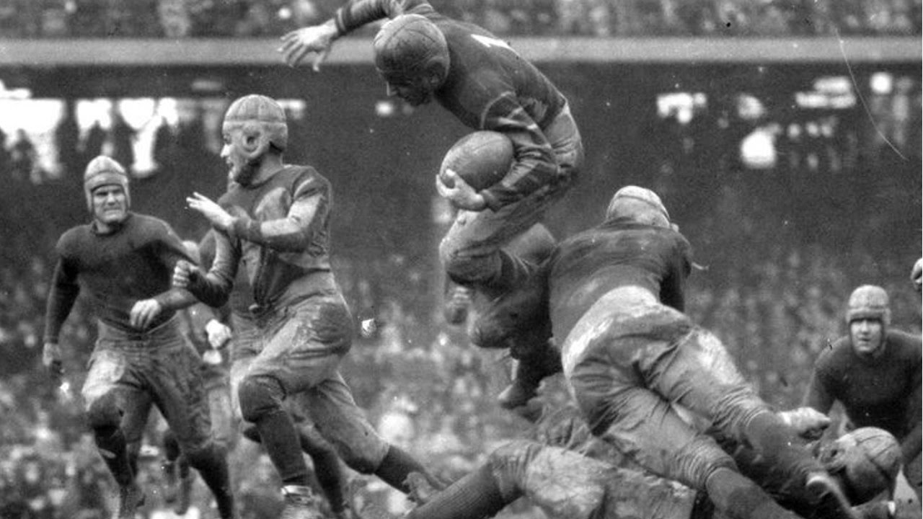

Slide 3
History of Football
National Football League (NFL), major U.S. professional gridiron football organization, founded in 1920 in Canton, Ohio
14 teams made up the original league, the Chicago Bears and the Arizona Cardinals are the only remaining teams.
The NFL and AFL completed a merger in 1970, creating a 26-team circuit under the name of the older NFL
The league now comprises of 32 franchises separated into 2 conferences and then into 4 divisions per conference
Notes:
five teams from Ohio (Akron Pros, Canton Bulldogs, Cleveland Tigers, Columbus Panhandlers, and Dayton Triangles), four teams from Illinois (Chicago Tigers, Decatur Staleys, Racine Cardinals [the Cardinals were based in Chicago but took the name of a local street], and Rock Island Independents), two from Indiana (Hammond Pros and Muncie Flyers), two from New York (Buffalo All-Americans and Rochester Jeffersons), and the Detroit Heralds from Michigan

Slide 4
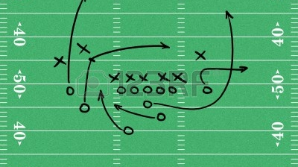

Slide 5
Breakdown of the Game
Each team uses 3 phases to compete with 11 per side.
Offense- 5-7 linemen, 1 Quarterback, 1-2 Tight Ends, 1-5 Wide Receivers, 1-3 Running Backs
Defense- 2-7 linemen, 2-4 Linebackers, 2-4 Cornerbacks, 1-3 Safeties
Special Teams- 3 forms still consisting of 11
Kickoff, Field Goal, and Punt teams

Slide 6
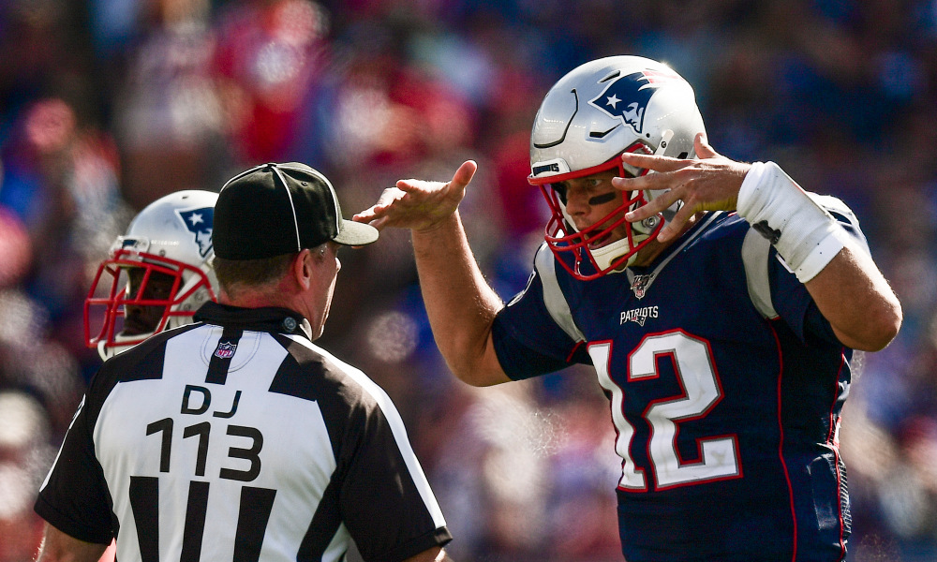

Slide 7
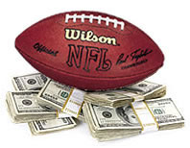
What problem are we trying to solve?
Looking to find correlations to a players statistical performance for an entire year in comparison to other players of the same position with varying salaries.

Slide 8
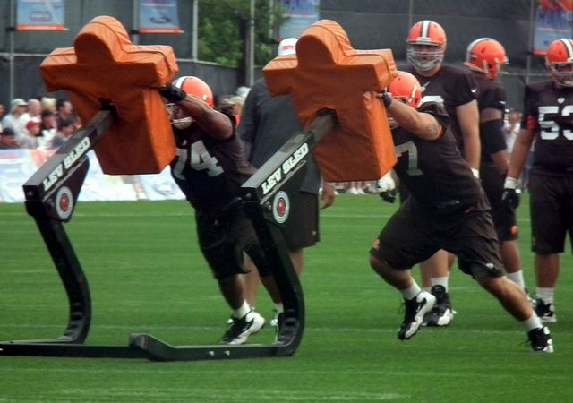

Slide 9
Scrapping for Stats
Used Selenium and Beautifulsoup in conjunction to gather the data from the following sites
https://www.pro-football-reference.com/ - found simple fantasy football style statistics
https://www.spotrac.com/nfl/- used to find the salary of every possible player under a current contract

Slide 10
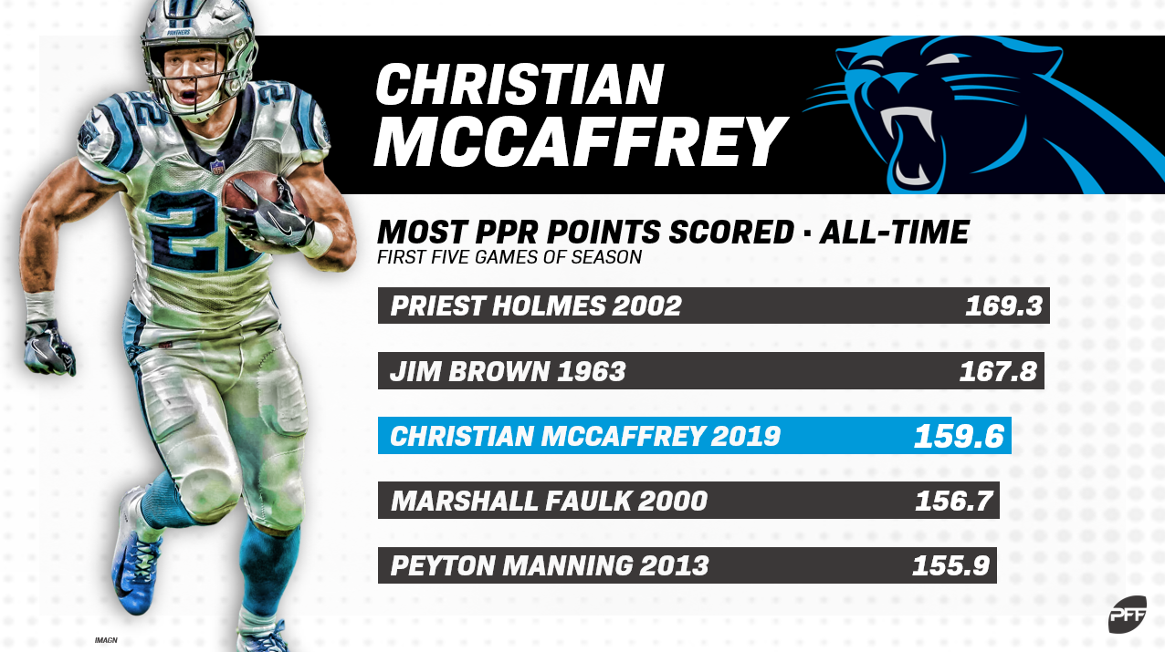

Slide 11
Which Statistics to use?
Defense - Positions tracked and stats available don’t easily reflect the impact a player may have
Offense - Easier to show how their contributions may affect the outcome of a game or season

Slide 12
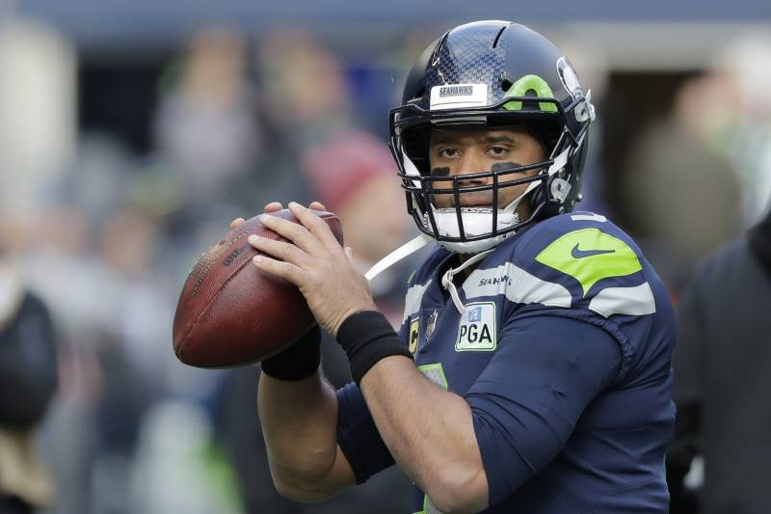

Slide 13
EDA of QB’s
COMP- Completions ATT- Attempts ATT/G- Attempts per Game YDS- Yards
300+ YDS- Number of Games Thrown Over 300 yards COMP%- Percentage of Completed Passes
YDS/ATT- Yards per Pass Attempt YDS/COMP- Yards per Completed Pass TD- Touchdowns
INT- Interceptions Thrown QBR- Quarterback Rating LONG- Longest Pass Completed
SACKS- Times Tackled Behind Line of Scrimmage SACK YDS- Total Yards Lost being Sacked
FUML- Fumbles that Resulted in a Turnover

Slide 14
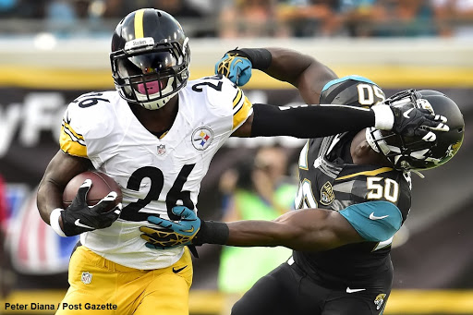

Slide 15
EDA of RB’s
ATT- Rushing Attempts YDS- Rushing Yards YDS/ATT- Yards per Rushing Attempt
ATT/G- Rushing Attempts per Game 100+ YDS- Games Eclipsing 100 Yards
TD- Touchdowns LONG- Longest Rush FUM- Everytime the Ball Hits the Ground after Control
FUML- Fumbles Resulting in Turnover

Slide 16
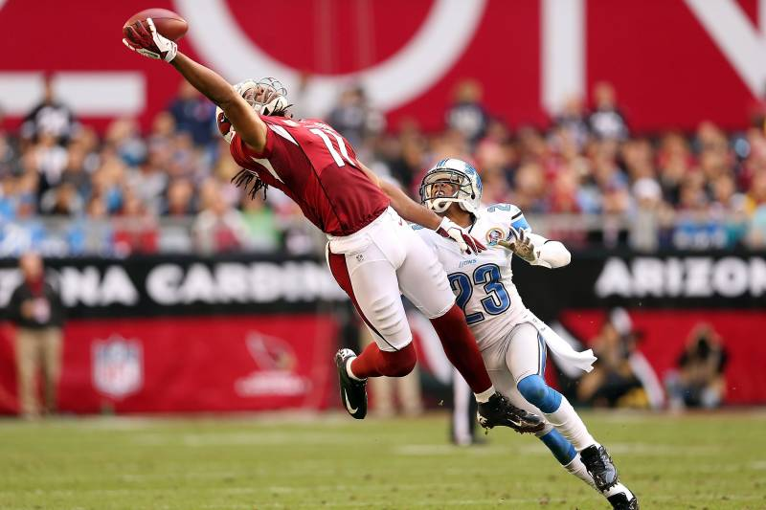

Slide 17
EDA of WR’s & TE’s
TGT- Targets REC- Receptions TGT/G- Targets per Game YDS- Yards Gained
100+ YDS- Games Eclipsing 100 Yards YDS/REC- Yards per Reception TD- Touchdowns
LONG- Longest Reception FUM- Every time the Ball Hits the Ground after Control
FUML- Fumbles Resulting in Turnover

Slide 18
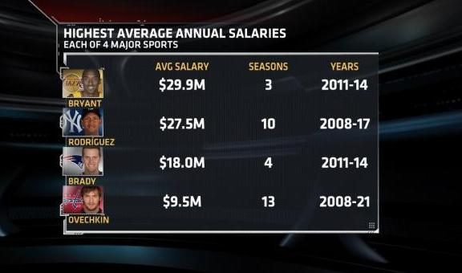
On the Hunt
Looking for individual stats explaining the difference between salaries.

Slide 19
Salary and Contract Averages
Median Salary- $860,000 per year
Average Career- 3.3 years
Highest Paid- Russell Wilson $35,000,000.00 per year
Rookie- $480,000 per year
Salary Cap- $201.2 million per team per year

Slide 20
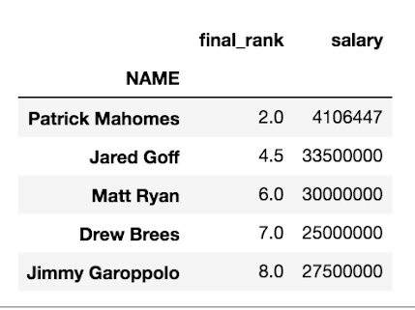
Manipulating Statistics
Built a ranking hierarchy based on simple performance stats.
Used the average rank amongst all stats to to find an overall rank value

Slide 21
Finding Relationships to Salary
Kmeans- Built many Kmeans clusters to find any statistic that would explain the reason for a higher wage.
Linear Regression- To find a linear relationship to statistical values and salary earned
Random Forest Classifier- Used to try and predict which of the four positions belonged to a series of stats and salary combinations.

Slide 22
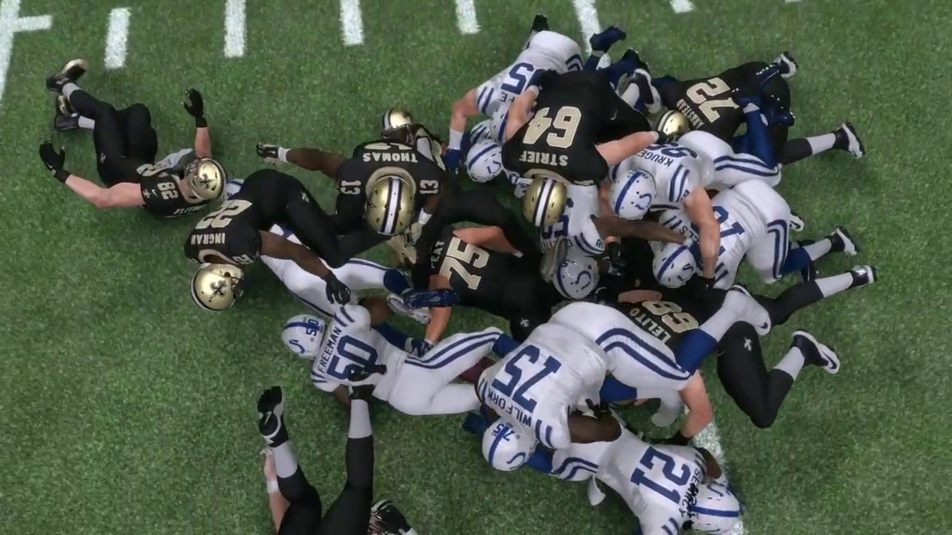

Slide 23
K-Means Clustering
k-means clustering is a method of vector quantization, originally from signal processing, that is popular for cluster analysis in data mining

Slide 24
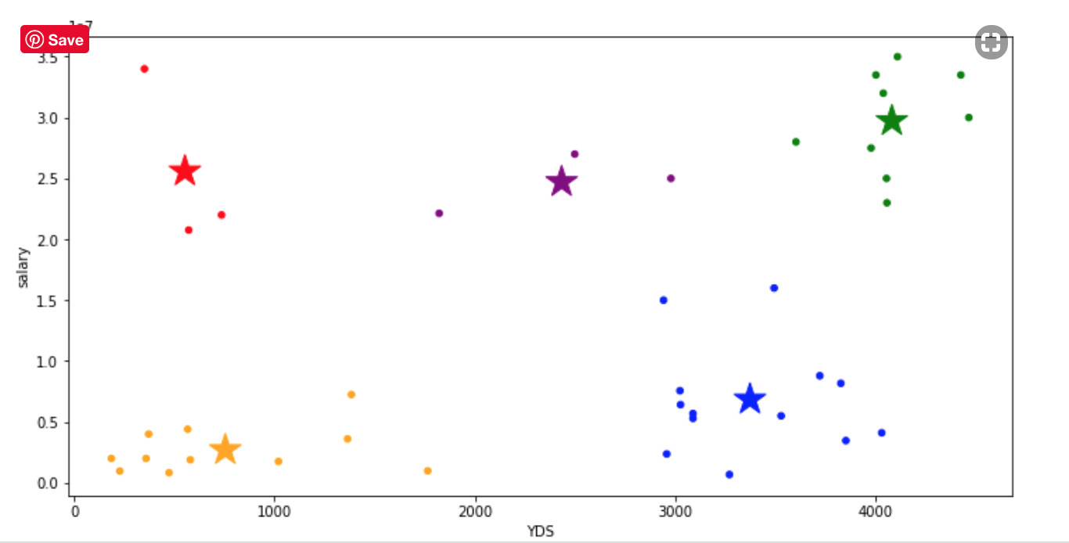
QB Cluster
Pass Yards - 0.601358 Silhouette Score

Slide 25
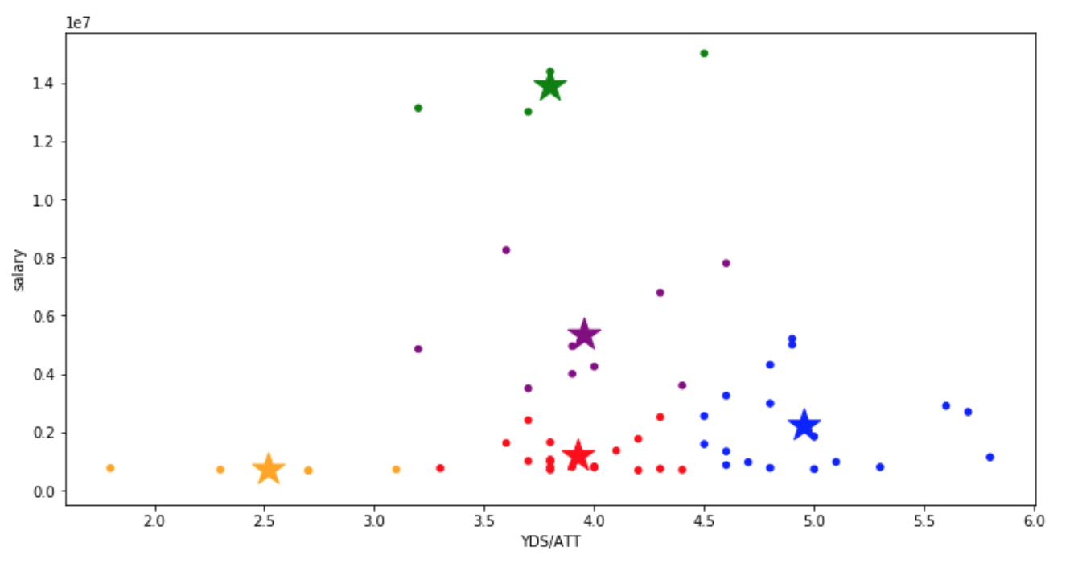
RB Cluster
Yards per Rush- 0.431057 Silhouette Score

Slide 26
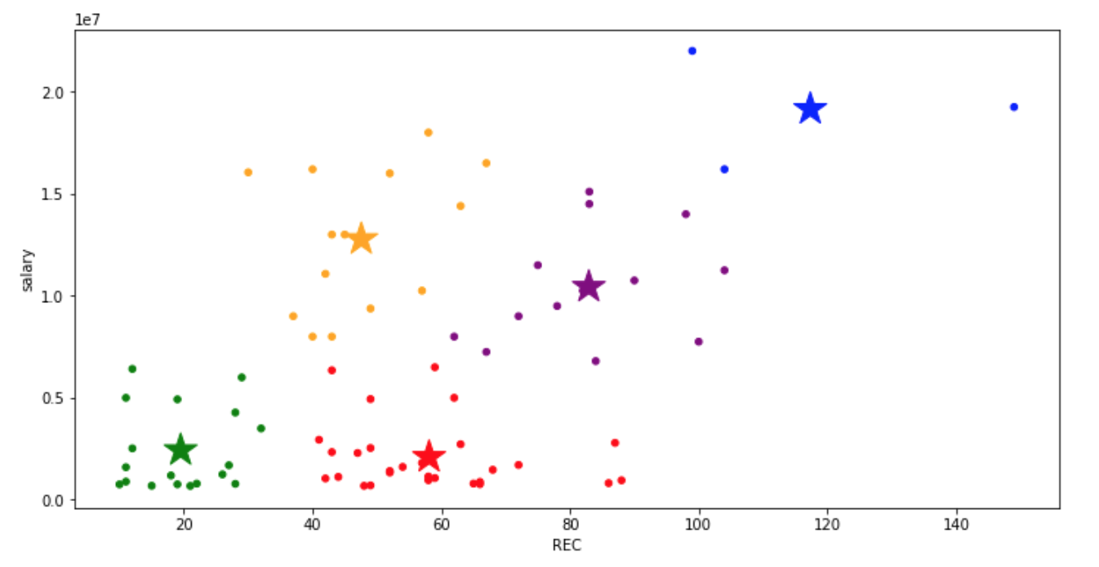
WR Cluster
Receptions- 0.45435778 Silhouette Score

Slide 27
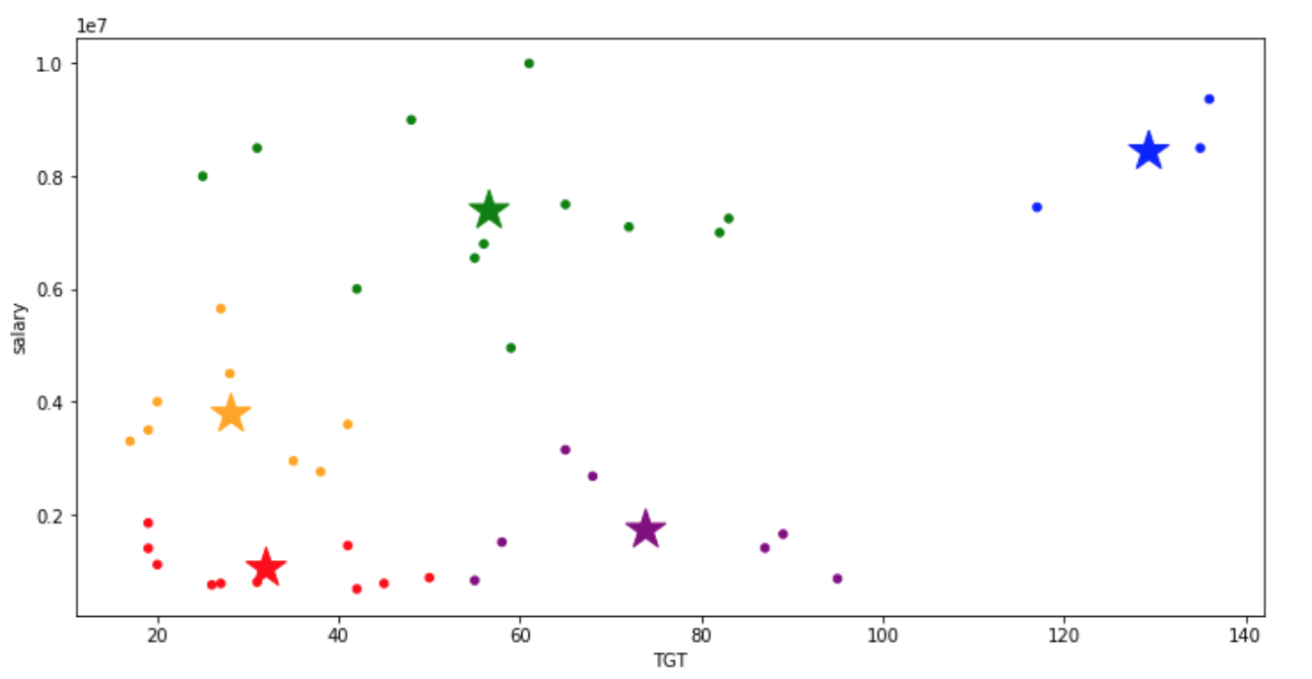
TE Cluster
Targets- 0.4303325 Silhouette Score

Slide 28
Clustering Conclusion
Not much was gained in form of distinguishing a single statistical column of importance
Could be used to show potential new platform to be paid based on other players current stats and salary.

Slide 29
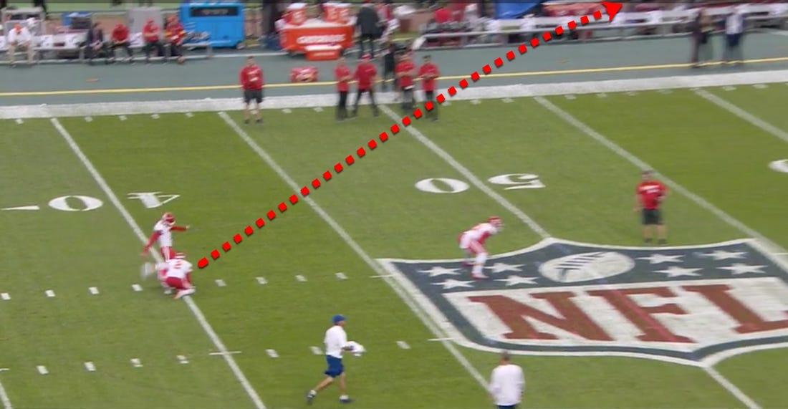

Slide 30
Linear Regression
In statistics, linear regression is a linear approach to modeling the relationship between a scalar response (or dependent variable) and one or more explanatory variables (or independent variables)

Slide 31
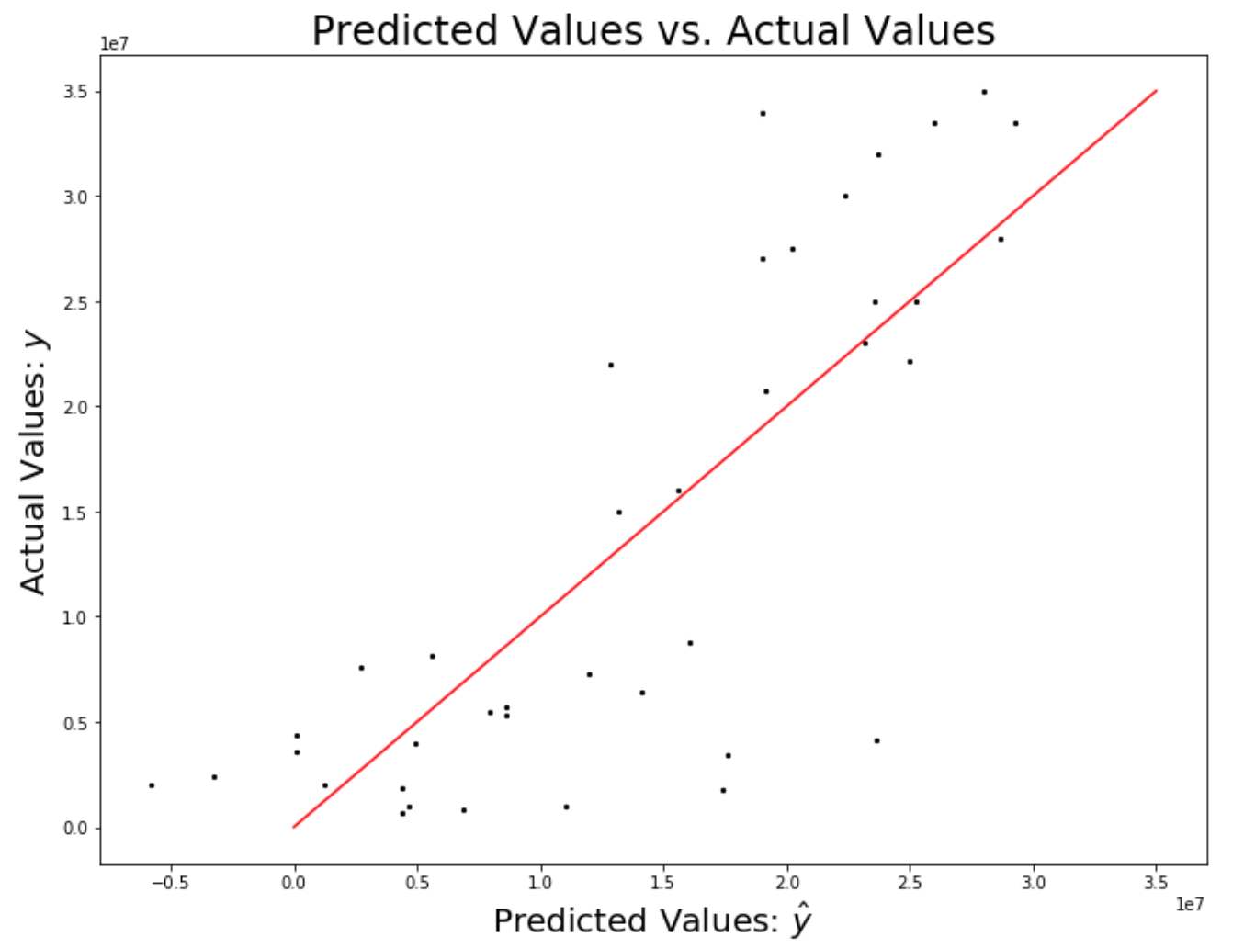
QB Linear Salary Predictions
R2 Score- 0.6399297

Slide 32
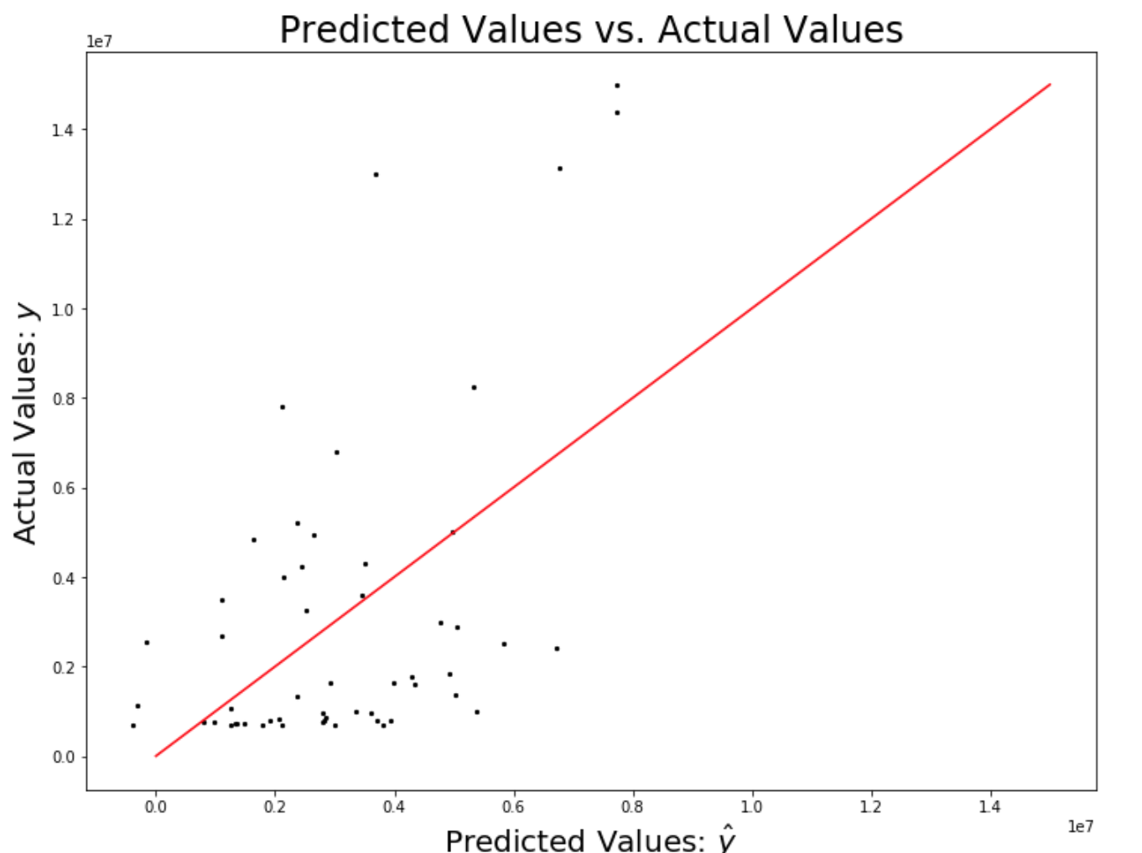
RB Linear Salary Predictions
R2 Score- 0.274803618

Slide 33
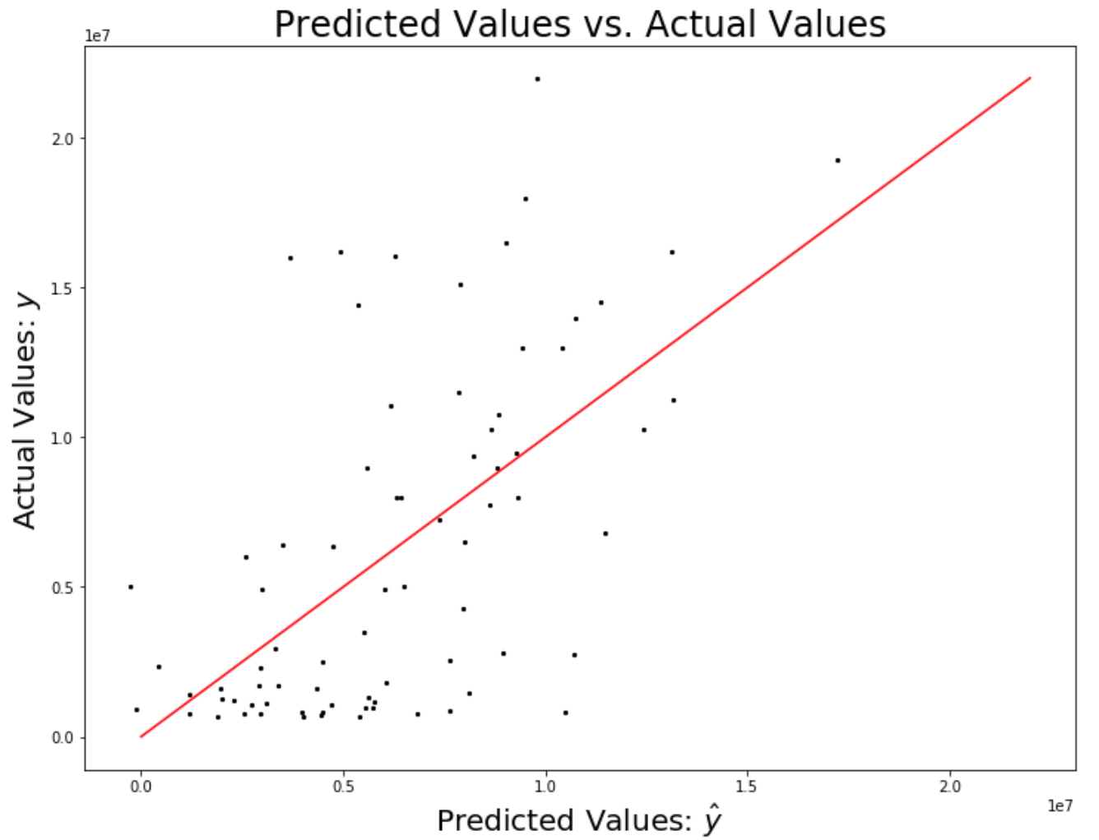
WR Linear Salary Predictions
R2 Score- 0.361483663

Slide 34
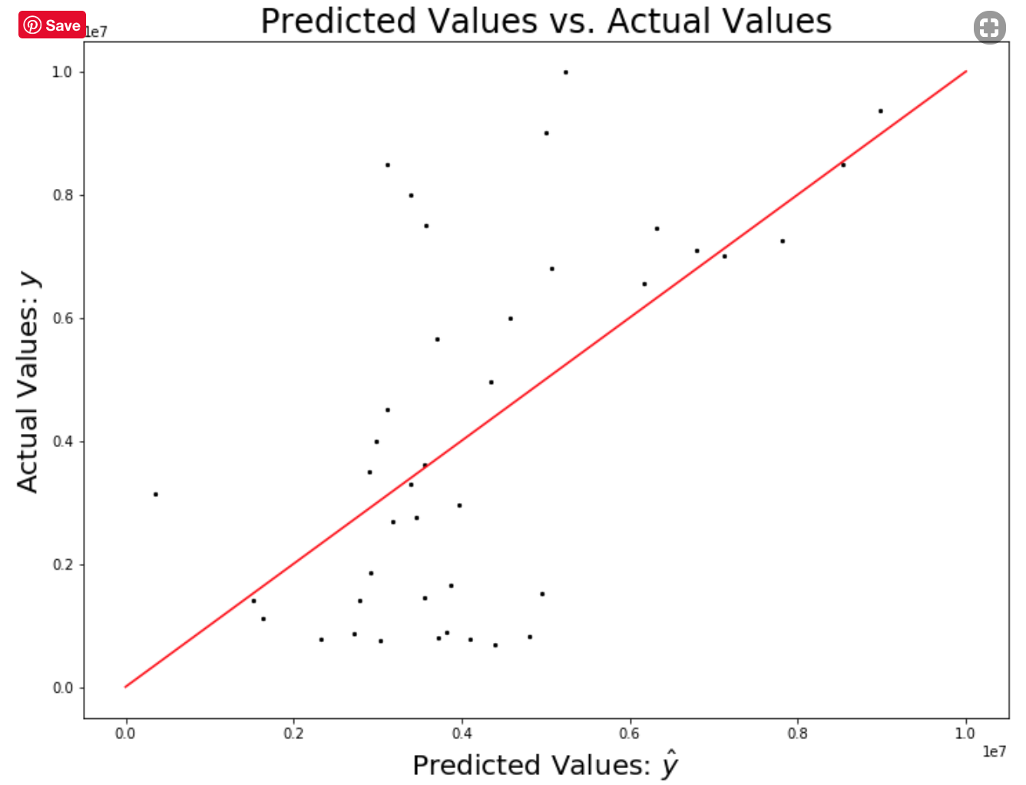
TE Linear Salary Predictions
R2 Score- 0.3721359

Slide 35
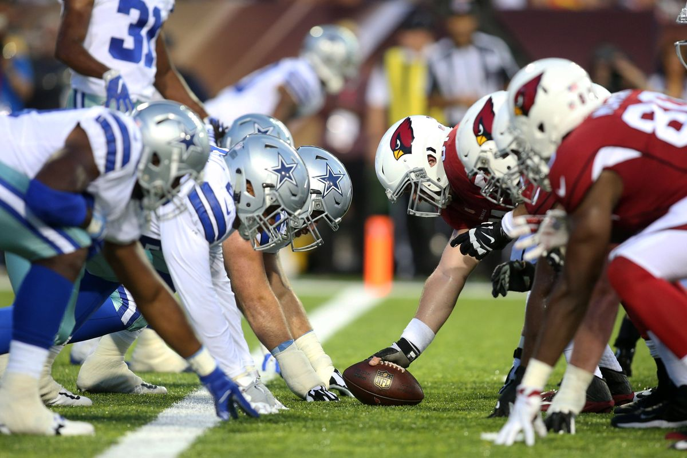

Slide 36
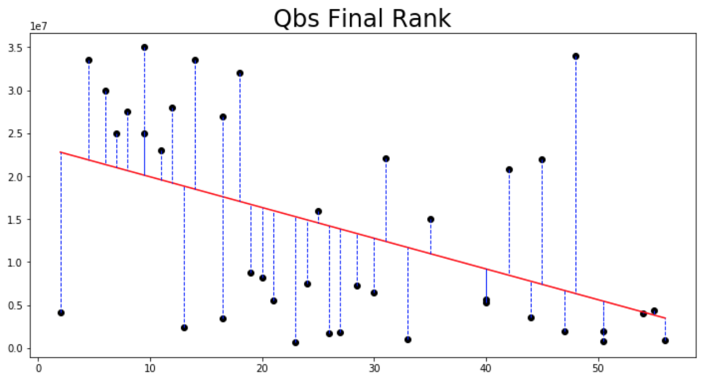
QB’s Rank/Salary Regression
Sqrt MSE- 10512166.886

Slide 37
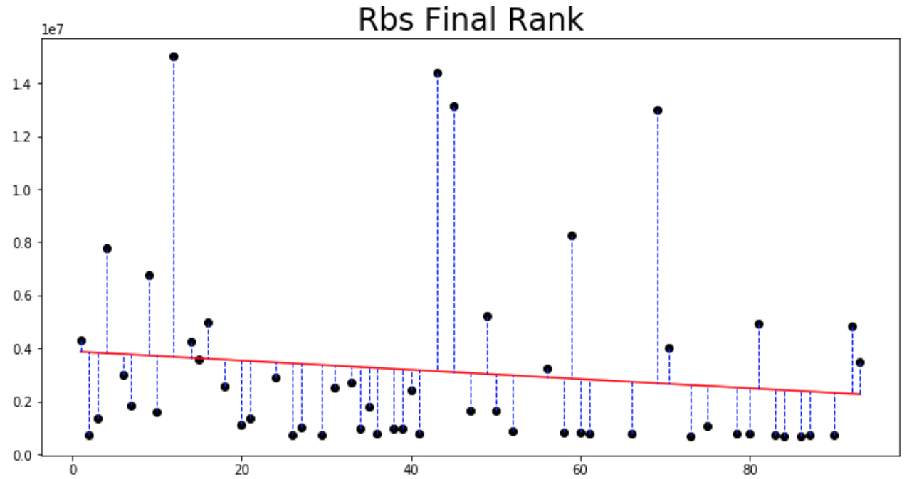
RB’s Rank/Salary Regression
Sqrt MSE- 3543708.455

Slide 38
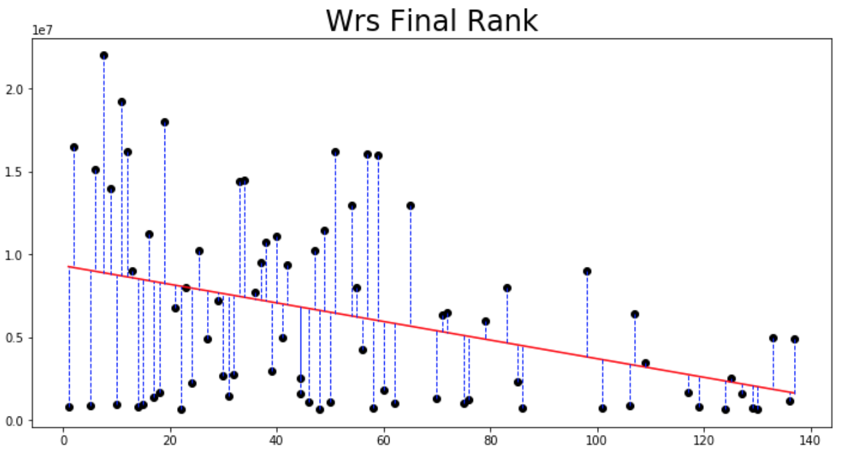
WR’s Rank/Salary Regression
Sqrt MSE- 5284640.561

Slide 39
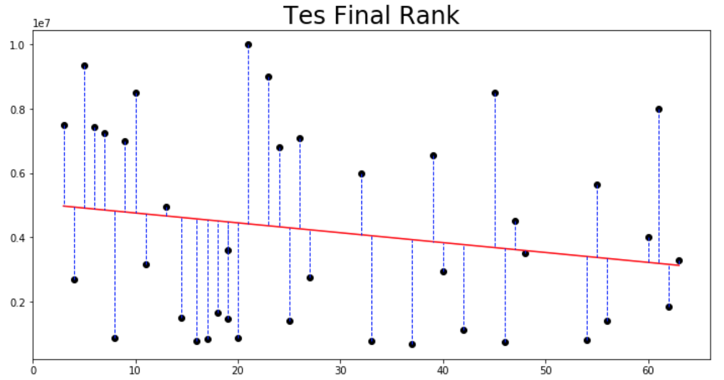
TE’s Rank/Salary Regression
Sqrt MSE- 2917992.382

Slide 40
Linear Regression Conclusion
The only useful class this can be used on is Quarterbacks without having further detailed stats that could help explain why the other three are getting paid at the values they earn.

Slide 41
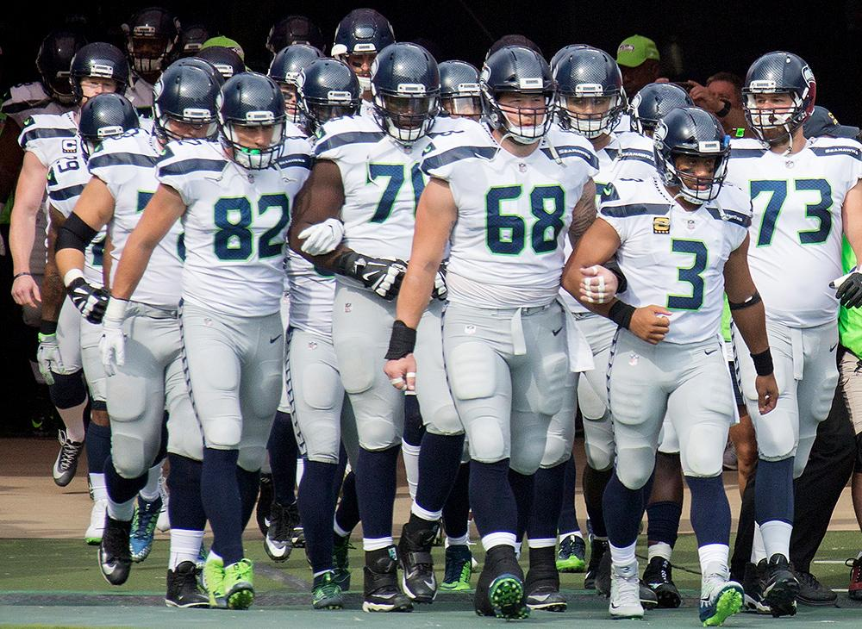

Slide 42
Random Forest Classifier
Random forests or random decision forests are an ensemble learning method for classification, regression and other tasks that operate by constructing a multitude of decision trees at training time and outputting the class that is the mode of the classes (classification) or mean prediction (regression) of the individual trees.

Slide 43
Random Forest Class Prediction
Gave each class their own numerical value to allow the model to predict between the four positions I have broken down and modeled.
Grid Searched each of the three years with the same parameters
Params- 'n_estimators' : [200, 225, 250, 275],
'max_depth' : [None, 2, 3, 5, 10, 15]
Train/Test Score- 1.0 / 0.8679245 19-20
1.0 / 0.8490566 18-19
1.0 / 0.8214285 17-18

Slide 44
Random Forest Conclusion
It does a pretty good job of indicating which class is related to which stats and salaries, but could possibly be going wrong with the tight ends and wide receivers having the most similar stats.

Slide 45
Conclusion
Overall there is not one single statistical reason for a player to make the salary they do but possibly with the combination of all possible stats, we may be able to derive a more true indicator of what a player should earn.

Slide 46
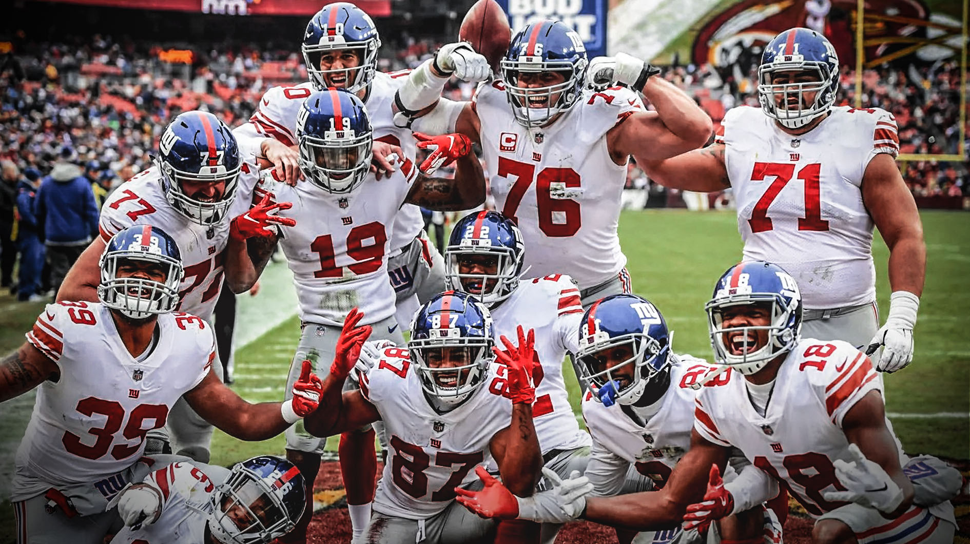
Questions??

